Slide 1

Survey design terminology

Slide 2
Survey design terminology:
Element: individuals or objects or units of interest.
  Usually made with reference to the population and/or sample.
Target population: the entire collection of the elements about which we wish to make inference on.
  I.e. the total finite population about which we require information.
  In an ideal world, this is the population we want to make inference on.

Slide 3
Survey design terminology:
Survey population: the population we actually sample from.
  Think of this as the population we realistically have access to.
  May be the same as the target population.
  May be a more limited, more accessible population, whose properties we hope can be extrapolated to the larger target population.
  Care must be taken when extending inference from this population to the target population.

Slide 4
Survey design terminology:
Characteristic: a variable of interest of the elements.
  Usually made with reference to the population and/or sample.
Population parameter: a mathematical function of the values of the variables across the whole population.
  E.g. average debt of UK graduates, proportion of UK population that are homeless.

Slide 5
Survey design terminology:
Sampling frame: a complete and up-to-date list of all the accessible elements in the population.
  I.e. what we would sample from.
  Usually a subset of the survey population.
Sample statistic: a mathematical function of the variables observed in the sample.

Slide 6
Survey design terminology:
Sampling units: the units or objects which form the sampling frame.
Sample: a collection of sampling units drawn from a sampling frame.
Data: the values of the variables in the sample (sometimes referred to as the sample).

Slide 7
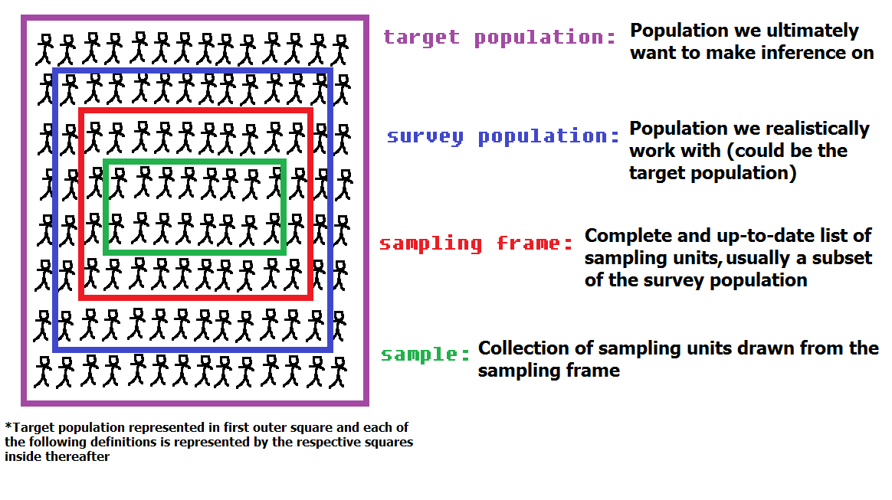
A rough visualisation of definitions…

